Slide 1
Filtration of lagging LPs (CCF approach)

Slide 2
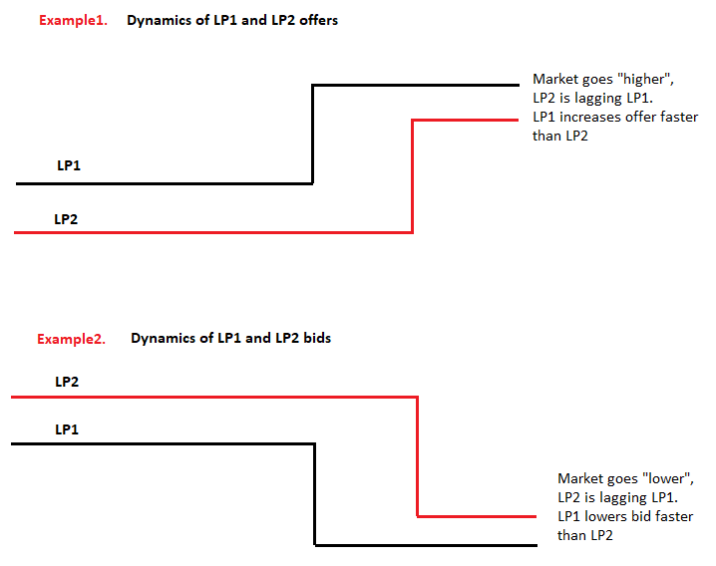
Lagging LPs. Motivation 1
“Winner” removes it’s offers when market “goes up” first
Winner removes it’s bids when market “goes down” first

Slide 3
Lagging LPs. Motivation 2
Why it is important remove lagging LPs ?
B-to-B cover strategy:
If lagging LP enables to trade at “stale” price - there is no problem;
It is likely that lagging LP will reject the order sent on “stale” price – Bank’s Client will also receive reject;
Position keeping strategy:
Negative spread in aggregator;
As result Bank quotes almost choice during volatile period;
This lowers expected Banks PnL from trades at this prices

Slide 4
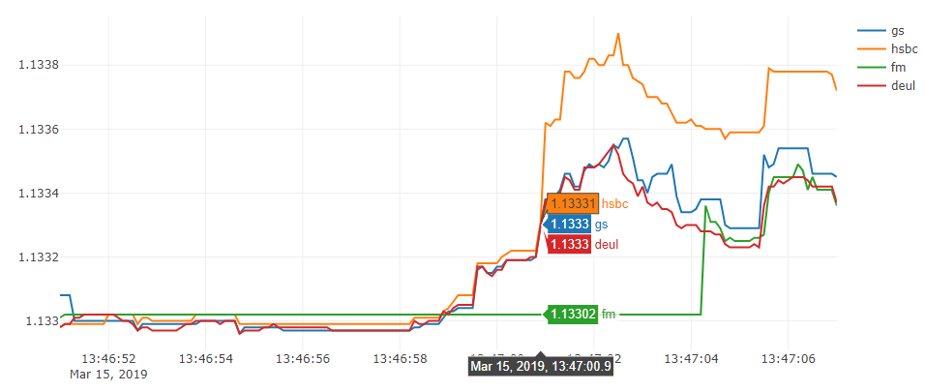
Lagging LPs. Identification 1
Plotting dynamics of tick bid/ask prices;
On figure below, plotted EUR/USD ask prices of GS, HSBC, DEUL and Fastmatch;
Fastmatch is lagging almost 5 seconds

Slide 5
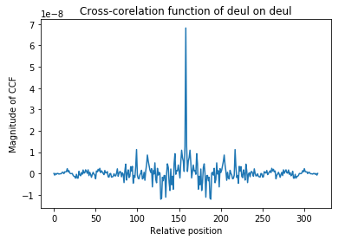
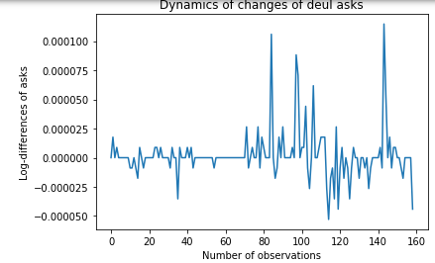
Lagging LPs. Identification 2
Cross-correlation function (CCF)
Applies to 2 time-series and identifies “degree of similarity”;
Enables to identify which time series is leading/lagging;
Applied to 2 identical time-series (right figure below) will have the form depicted on left figure below with maximum value at the middle (Relative position = 161);
Maximums to the “right/left” of the middle correspond to lags/leads relative to “base” LP

Slide 6
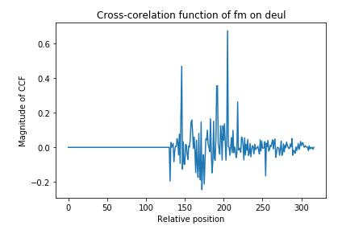
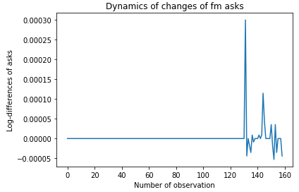
Lagging LPs. Results 1
CCF of FM on DEUL has maximum with relative position =207 (left figure below), which correspond to 46 position from the middle (161);
Each step correspond to 100 ms. We can vary this parameter to choose the sampling frequency of LPs bids/asks: tick, 10 ms, 50 ms and so on;
Lag of FM relative to DEUL is 46*100 ms = 4600 ms

Slide 7
Lagging LPs. Results 2
Applying CCF approach to other pairs (HSBC, DEUL) and (GS, DEUL) we find that:
HSBC is 15 ms lagging DEUL;
GS is 7 ms leading DEUL
CCF approach works well on obvious cases shown on Slide 2, when prices go in one direction with gaps;
CCF could show noisy pictures when there is more than 1 huge spikes above and below the “middle position” and we can not say which one LP is leading/lagging;
Actually, LP1 could lead LP2 some periods of time and lag during other periods;
Bottom line: current method could be applied to identify lagging LPs, but it requires dealers’ intervention

Slide 8
Appendix
Python code on GitHub: https://github.com/rrgareev/git_repo/tree/master/Market%20data%20analysis

